Slide 1
Chapter 7
Photosynthesis: Using Light to Make Food

Slide 2
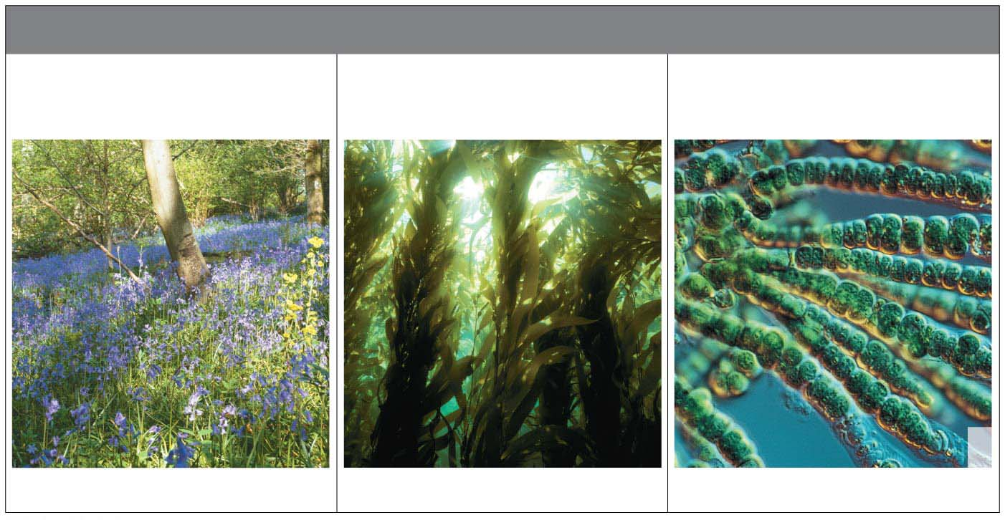
The Basics of Photosynthesis광합성
Photosynthesis
is used by plants, algae (protists원생생물), and certain bacteria,
transforms light energy into chemical energy— photoautotrophs광독립영양생물
uses carbon dioxide and water as starting materials, and
releases oxygen gas as a by-product.
Plants
(mostly on land)
Photosynthetic
Protists
Photosynthetic
Bacteria
Notes:
2
Student Misconceptions and Concerns
1. Students often do not fully understand how the burning of fossil fuels contributes to global warming. They might wonder, “How does the burning of fossil fuels differ from the burning of ethanol produced from crops?” Students might not realize that the carbon in fossil fuels was removed from the atmosphere hundreds of millions of years ago, while the carbon in crops was removed much more recently, when the crops were grown. The use of ethanol as an alternative is complicated by the typical reliance upon fossil fuels for ethanol production.
2. Some students do not realize that plant cells also have mitochondria. Instead, they assume that the chloroplasts are sufficient for the plant cell’s needs. But nearly 50% of the carbohydrates produced by plant cells are used for cellular respiration (involving mitochondria).
3. Students may not connect the growth in plant mass to the fixation of carbon during the Calvin cycle. It can be difficult for many students to appreciate that molecules in air can contribute significantly to the mass of plants.
4. Students may understand the overall chemical relationships between photosynthesis and cellular respiration, but many struggle to understand the use of carbon dioxide in the Calvin cycle. Photosynthesis is much more than gas exchange.
5. Students who have not read all of Chapter 7 may not realize that glucose is not the direct product of photosynthesis. Although glucose is shown as a product of photosynthesis, a three-carbon sugar is directly produced (G3P). A plant can use G3P to make many types of organic molecules, including glucose. (The authors address the production of G3P under the section “The Calvin Cycle” later in this chapter.)
Teaching Tips
1. The living world contains many examples of adaptations to increase surface area. Some examples are the many folds of the inner mitochondrial membrane, the highly branched surfaces of fish gills and human lungs, and the highly branched system of capillaries in the tissues of our bodies. Consider relating this broad principle seen elsewhere to the extensive folding of the thylakoid membranes.
2. In our world, energy is frequently converted to a usable form in one place and used in another. For example, electricity is generated by power plants, transferred to our homes, and used to run computers, create light, and help us prepare foods. Consider relating this common energy transfer to the two-stage process of photosynthesis.
3. You might wish to discuss the evolution of chloroplasts from photosynthetic prokaryotes if you will not address this subject elsewhere in your course.
4. Figure 7.3 is an important visual organizer that notes the key structures and functions of the two stages of photosynthesis. This figure reminds students where water and sunlight are used in the thylakoid membranes to generate oxygen, ATP, and NADPH. The second step, in the stroma, reveals the use of carbon dioxide, ATP, and NADPH to generate sugar.
5. The thylakoid space and the intermembrane space of a mitochondrion have analogous roles. Students might be encouraged to create a list of the similarities in structure and function of mitochondria and chloroplasts through these related chapters.
Active Lecture Tips
1. When introducing the diverse ways that plants impact our lives, challenge your students to work with others seated nearby to come up with a list of products made from plants that they encounter on a regular basis. The collective lists from your students can be surprisingly long and might help you build your own catalog of examples.
2. See the activity Photosynthesis and Respiration: Are They Similar? on the Instructor Exchange. Visit the Instructor Exchange in the MasteringBiology instructor resource area for a description of this activity.
3. See the activity Demonstration of the Light-Dependent Reactions of Photosynthesis Using Students as Molecules on the Instructor Exchange. Visit the Instructor Exchange in the MasteringBiology instructor resource area for a description of this activity.

Slide 3
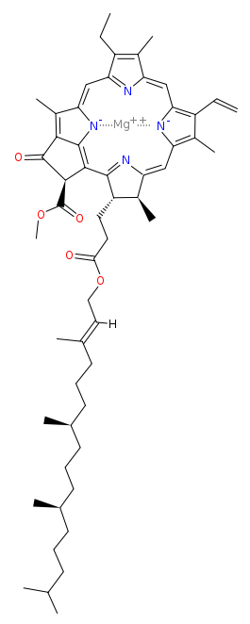
Chloroplasts: Sites of Photosynthesis
Chloroplasts엽록체 are
light-absorbing organelles,
the site of photosynthesis, and
found mostly in the interior cells of leaves.
Their green color is from chlorophyll엽록소, a pigment (light-absorbing molecule) in the chloroplasts that plays a central role in converting solar energy to chemical energy.
Notes:
3
Student Misconceptions and Concerns
1. Students often do not fully understand how the burning of fossil fuels contributes to global warming. They might wonder, “How does the burning of fossil fuels differ from the burning of ethanol produced from crops?” Students might not realize that the carbon in fossil fuels was removed from the atmosphere hundreds of millions of years ago, while the carbon in crops was removed much more recently, when the crops were grown. The use of ethanol as an alternative is complicated by the typical reliance upon fossil fuels for ethanol production.
2. Some students do not realize that plant cells also have mitochondria. Instead, they assume that the chloroplasts are sufficient for the plant cell’s needs. But nearly 50% of the carbohydrates produced by plant cells are used for cellular respiration (involving mitochondria).
3. Students may not connect the growth in plant mass to the fixation of carbon during the Calvin cycle. It can be difficult for many students to appreciate that molecules in air can contribute significantly to the mass of plants.
4. Students may understand the overall chemical relationships between photosynthesis and cellular respiration, but many struggle to understand the use of carbon dioxide in the Calvin cycle. Photosynthesis is much more than gas exchange.
5. Students who have not read all of Chapter 7 may not realize that glucose is not the direct product of photosynthesis. Although glucose is shown as a product of photosynthesis, a three-carbon sugar is directly produced (G3P). A plant can use G3P to make many types of organic molecules, including glucose. (The authors address the production of G3P under the section “The Calvin Cycle” later in this chapter.)
Teaching Tips
1. The living world contains many examples of adaptations to increase surface area. Some examples are the many folds of the inner mitochondrial membrane, the highly branched surfaces of fish gills and human lungs, and the highly branched system of capillaries in the tissues of our bodies. Consider relating this broad principle seen elsewhere to the extensive folding of the thylakoid membranes.
2. In our world, energy is frequently converted to a usable form in one place and used in another. For example, electricity is generated by power plants, transferred to our homes, and used to run computers, create light, and help us prepare foods. Consider relating this common energy transfer to the two-stage process of photosynthesis.
3. You might wish to discuss the evolution of chloroplasts from photosynthetic prokaryotes if you will not address this subject elsewhere in your course.
4. Figure 7.3 is an important visual organizer that notes the key structures and functions of the two stages of photosynthesis. This figure reminds students where water and sunlight are used in the thylakoid membranes to generate oxygen, ATP, and NADPH. The second step, in the stroma, reveals the use of carbon dioxide, ATP, and NADPH to generate sugar.
5. The thylakoid space and the intermembrane space of a mitochondrion have analogous roles. Students might be encouraged to create a list of the similarities in structure and function of mitochondria and chloroplasts through these related chapters.
Active Lecture Tips
1. When introducing the diverse ways that plants impact our lives, challenge your students to work with others seated nearby to come up with a list of products made from plants that they encounter on a regular basis. The collective lists from your students can be surprisingly long and might help you build your own catalog of examples.
2. See the activity Photosynthesis and Respiration: Are They Similar? on the Instructor Exchange. Visit the Instructor Exchange in the MasteringBiology instructor resource area for a description of this activity.
3. See the activity Demonstration of the Light-Dependent Reactions of Photosynthesis Using Students as Molecules on the Instructor Exchange. Visit the Instructor Exchange in the MasteringBiology instructor resource area for a description of this activity.

Slide 4
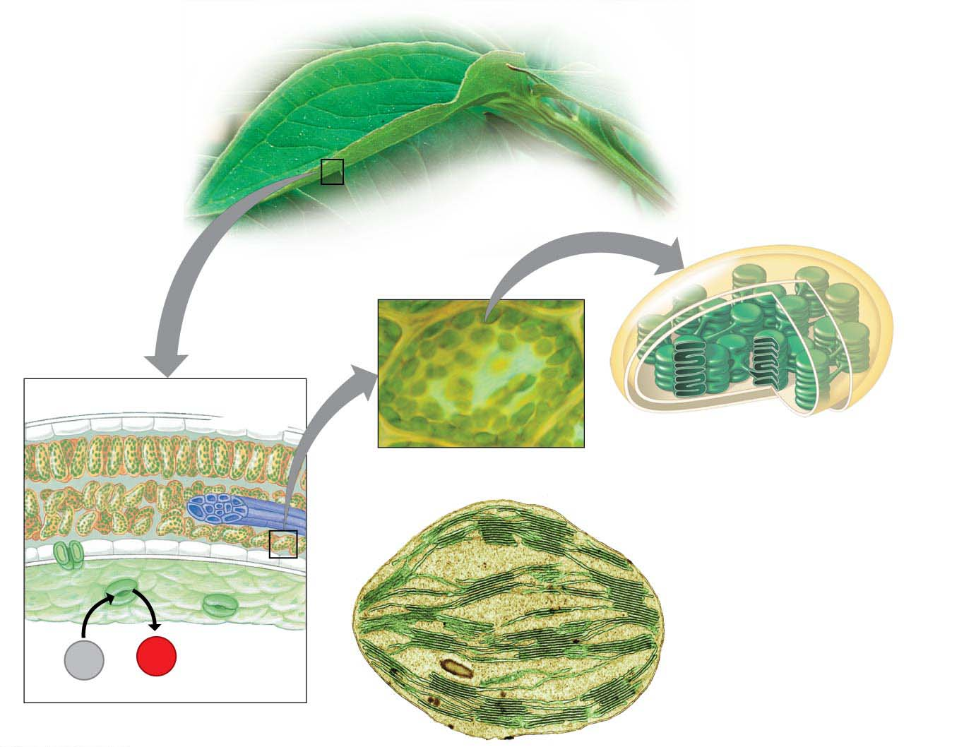
Figure 7.2-s3
Inner and outer membranes
Photosynthetic
cells
LM
Vein
Stroma
Thylakoid
Interior cell
Chloroplast
Thylakoid
space
Granum
CO₂
O₂
Stomata
Colorized TEM
Leaf cross section
Notes:
Figure 7.2-s3 Journey into a leaf (step 3)

Slide 5
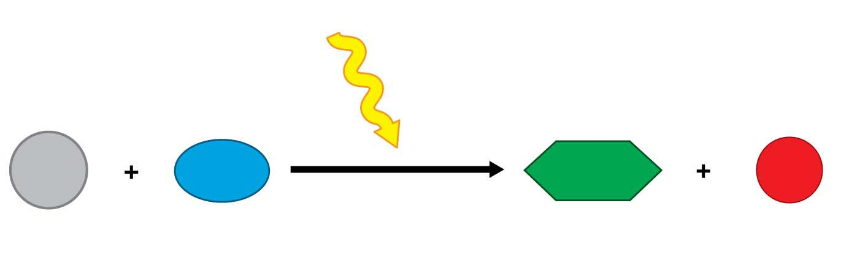
Figure 7.UN03
Light energy
6 CO₂
6 H₂O
C₆H₁₂O₆
6 O₂
Photosynthesis
Carbon
dioxide
Water
Glucose
Oxygen gas
Notes:
Figure 7.UN03 Summary of key concepts: photosynthesis equation

Slide 6
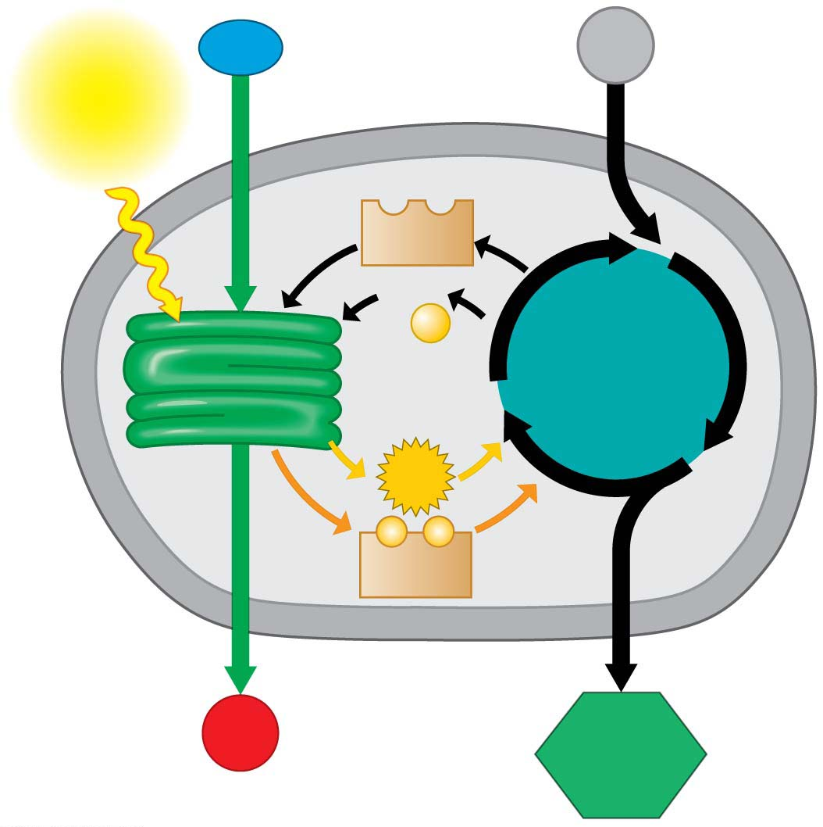
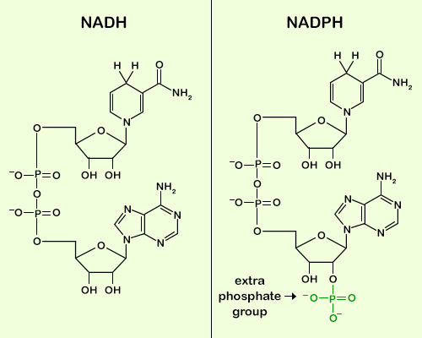
Figure 7.3-s2
H₂O
Chloroplast
CO₂
Light
NADP⁺
ADP
+
P
Light
reactions
Calvin
cycle
ATP
⁻
⁻
NADPH
O₂
Sugar
Notes:
Figure 7.3-s2 A road map for photosynthesis (step 2)

Slide 7
Energy Transformations: An Overview of Photosynthesis
Photosynthesis occurs in two stages.
In the light reactions광반응,
chlorophyll in the thylakoid membranes absorbs solar energy, which is then converted to the chemical energy of ATP and NADPH, and
water is split, providing a source of electrons and giving off O₂ gas as a by-product.
The Calvin cycle uses the products of the light reactions to make sugar from carbon dioxide, starting from the carbon fixation reaction.
Notes:
7
Student Misconceptions and Concerns
1. Students often do not fully understand how the burning of fossil fuels contributes to global warming. They might wonder, “How does the burning of fossil fuels differ from the burning of ethanol produced from crops?” Students might not realize that the carbon in fossil fuels was removed from the atmosphere hundreds of millions of years ago, while the carbon in crops was removed much more recently, when the crops were grown. The use of ethanol as an alternative is complicated by the typical reliance upon fossil fuels for ethanol production.
2. Some students do not realize that plant cells also have mitochondria. Instead, they assume that the chloroplasts are sufficient for the plant cell’s needs. But nearly 50% of the carbohydrates produced by plant cells are used for cellular respiration (involving mitochondria).
3. Students may not connect the growth in plant mass to the fixation of carbon during the Calvin cycle. It can be difficult for many students to appreciate that molecules in air can contribute significantly to the mass of plants.
4. Students may understand the overall chemical relationships between photosynthesis and cellular respiration, but many struggle to understand the use of carbon dioxide in the Calvin cycle. Photosynthesis is much more than gas exchange.
5. Students who have not read all of Chapter 7 may not realize that glucose is not the direct product of photosynthesis. Although glucose is shown as a product of photosynthesis, a three-carbon sugar is directly produced (G3P). A plant can use G3P to make many types of organic molecules, including glucose. (The authors address the production of G3P under the section “The Calvin Cycle” later in this chapter.)
Teaching Tips
1. The living world contains many examples of adaptations to increase surface area. Some examples are the many folds of the inner mitochondrial membrane, the highly branched surfaces of fish gills and human lungs, and the highly branched system of capillaries in the tissues of our bodies. Consider relating this broad principle seen elsewhere to the extensive folding of the thylakoid membranes.
2. In our world, energy is frequently converted to a usable form in one place and used in another. For example, electricity is generated by power plants, transferred to our homes, and used to run computers, create light, and help us prepare foods. Consider relating this common energy transfer to the two-stage process of photosynthesis.
3. You might wish to discuss the evolution of chloroplasts from photosynthetic prokaryotes if you will not address this subject elsewhere in your course.
4. Figure 7.3 is an important visual organizer that notes the key structures and functions of the two stages of photosynthesis. This figure reminds students where water and sunlight are used in the thylakoid membranes to generate oxygen, ATP, and NADPH. The second step, in the stroma, reveals the use of carbon dioxide, ATP, and NADPH to generate sugar.
5. The thylakoid space and the intermembrane space of a mitochondrion have analogous roles. Students might be encouraged to create a list of the similarities in structure and function of mitochondria and chloroplasts through these related chapters.
Active Lecture Tips
1. When introducing the diverse ways that plants impact our lives, challenge your students to work with others seated nearby to come up with a list of products made from plants that they encounter on a regular basis. The collective lists from your students can be surprisingly long and might help you build your own catalog of examples.
2. See the activity Photosynthesis and Respiration: Are They Similar? on the Instructor Exchange. Visit the Instructor Exchange in the MasteringBiology instructor resource area for a description of this activity.
3. See the activity Demonstration of the Light-Dependent Reactions of Photosynthesis Using Students as Molecules on the Instructor Exchange. Visit the Instructor Exchange in the MasteringBiology instructor resource area for a description of this activity.

Slide 8
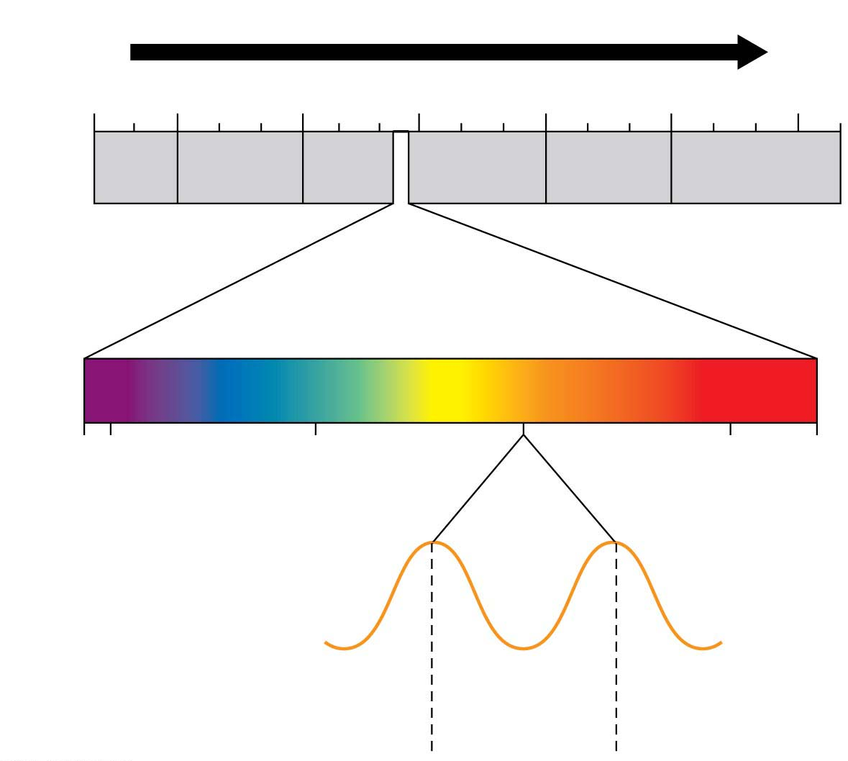
Figure 7.4
Increasing wavelength
10⁻⁵ nm
10⁻³ nm
1 nm
10³ nm
10⁶ nm
1 m
10³ m
Gamma
rays
X-rays
UV
Infrared
Micro-
waves
Radio
waves
Highest
energy
Lowest
energy
Visible light
가시광선
380
400
500
600
700
750
Wavelength (nm)
The Nature of Sunlight
Wavelength =
580
nm
Notes:
Figure 7.4 The electromagnetic spectrum

Slide 9
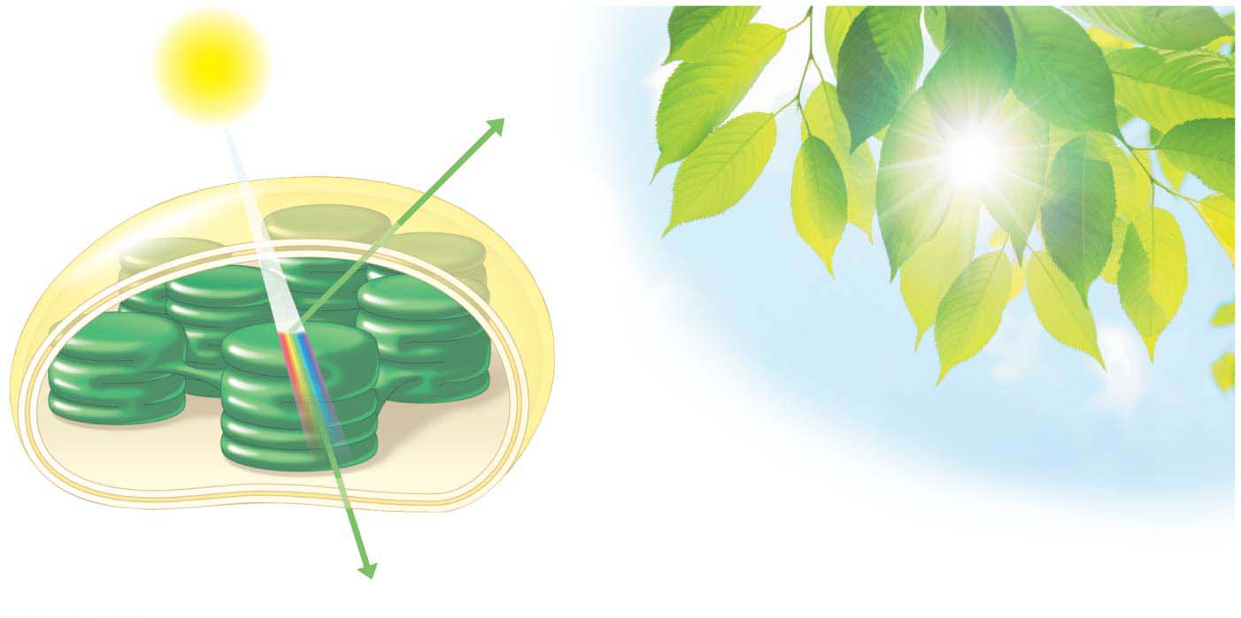
Figure 7.6
Light
Reflected
light
Chloroplast
Absorbed
light
Transmitted
light (detected
by your eye)
Notes:
Figure 7.6 Why are leaves green?

Slide 10
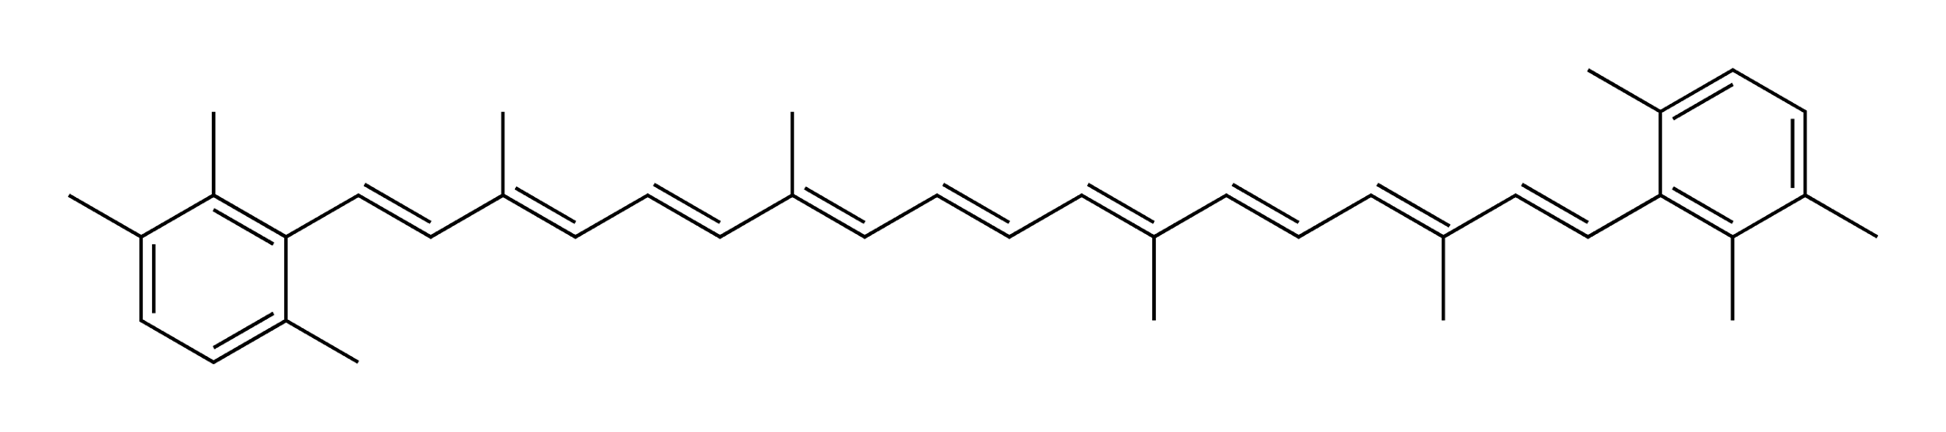
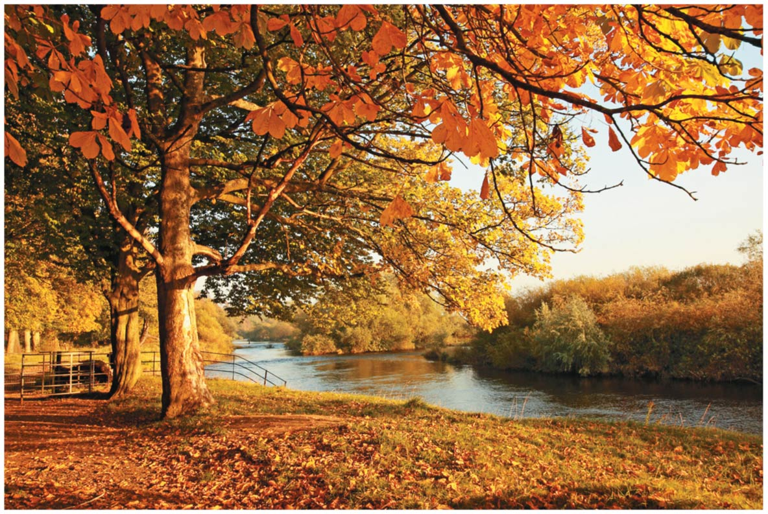
Chloroplast Pigments
Chloroplasts contain several different pigments that absorb light of different wavelengths.
Chlorophyll a
participates directly in the light reactions and
absorbs mainly blue-violet and red light.
Chlorophyll b
is very similar to chlorophyll a,
absorbs mainly blue and orange light, and
conveys absorbed energy to chlorophyll a.
Carotenoids
absorb mainly blue-green light and
absorb and dissipate excessive light energy that might damage chlorophyll.
Beta-carotene is a bright orange/red pigment found in pumpkins,
sweet potatoes, and carrots and is converted to vitamin A
in the body.
Lycopene is a bright red pigment found in tomatoes, watermelon,
and red peppers and is an antioxidant that is being studied for
potential anti-cancer properties.
Notes:
10
Student Misconceptions and Concerns
1. The authors note that sunlight is a type of radiation. Many students think of radiation as a result of radioactive decay, a serious threat to health. The diverse types of radiation and the varying energy associated with each might need to be explained.
2. The authors note that electromagnetic energy travels through space in waves that are like those made by a pebble dropped in a pond. This wave imagery is helpful, but can confuse students when energy is also thought of as discrete packets called photons. The dual nature of light as a wave and particle may need to be discussed further if students are to do more than just accept the definitions.
3. The light reactions are not solely responsible for all of the products in the general chemical equation of photosynthesis. Point out that oxygen is generated in the light reactions but that glucose results from products of the Calvin cycle.
4. Even at the college level, students struggle to understand why we perceive certain colors. The authors discuss the specific absorption and reflection of certain wavelengths of light, noting which colors are absorbed and which are reflected (and thus available for our eyes to detect). Consider spending time to make sure that your students understand how photosynthetic pigments absorb and reflect certain wavelengths.
Teaching Tips
1. Consider bringing a prism to class and demonstrating the spectrum of visible light. Depending on what you have available, it can be a dramatic reinforcement of this key concept. You might show an image of a rainbow if you are willing to explain how it is produced.
2. Consider bringing a glow stick to class just to help illustrate the authors’ note about the light-generating reactions in glow sticks. Small demonstrations break up lectures and stir attention.
3. The authors discuss a phenomenon that most students have noticed: Dark surfaces heat up faster in the sun than lighter-colored surfaces. This is an opportunity to demonstrate to your students the various depths of scientific explanations and help them appreciate their own educational progress. In elementary school, they might have learned that the sun heats darker surfaces faster than lighter surfaces. In high school, they may have learned about light energy and the fact that dark surfaces absorb more of this energy than lighter surfaces. Now, in college, they are learning that at the atomic level, darker surfaces absorb the energy of more photons, exciting more electrons, which then fall back to a lower state, releasing more heat.
4. The authors develop a mechanical analogy to the energy levels and movement of electrons in the light reaction. Figure 7.12 equates the height of an electron with its energy state. Thus, electrons captured at high levels carry more energy than electrons in lower positions. Although this figure can be very effective, students might need to be carefully led through the analogy to understand precisely what is represented.
Active Lecture Tips
1. See the activity Demonstration of the Light-Dependent Reactions of Photosynthesis Using Students as Molecules on the Instructor Exchange. Visit the Instructor Exchange in the MasteringBiology instructor resource area for a description of this activity.
2. See the activity Satellite TV and Photosystems on the Instructor Exchange. Visit the Instructor Exchange in the MasteringBiology instructor resource area for a description of this activity.

Slide 11
How Photosystems광계 Harvest Light Energy
Light behaves as
waves and
discrete packets of energy called photons광자, fixed quantities of light energy.
The shorter the wavelength of light, the greater the energy of a photon.
When a pigment molecule absorbs a photon, one of the pigment’s electrons gains energy.
This electron is now said to be “excited.”
The excited state is highly unstable.
An excited electron usually loses its excess energy and falls back to its ground state almost immediately.
Most pigments release heat energy as their light-excited electrons fall back to their ground state.
Notes:
11
Student Misconceptions and Concerns
1. The authors note that sunlight is a type of radiation. Many students think of radiation as a result of radioactive decay, a serious threat to health. The diverse types of radiation and the varying energy associated with each might need to be explained.
2. The authors note that electromagnetic energy travels through space in waves that are like those made by a pebble dropped in a pond. This wave imagery is helpful, but can confuse students when energy is also thought of as discrete packets called photons. The dual nature of light as a wave and particle may need to be discussed further if students are to do more than just accept the definitions.
3. The light reactions are not solely responsible for all of the products in the general chemical equation of photosynthesis. Point out that oxygen is generated in the light reactions but that glucose results from products of the Calvin cycle.
4. Even at the college level, students struggle to understand why we perceive certain colors. The authors discuss the specific absorption and reflection of certain wavelengths of light, noting which colors are absorbed and which are reflected (and thus available for our eyes to detect). Consider spending time to make sure that your students understand how photosynthetic pigments absorb and reflect certain wavelengths.
Teaching Tips
1. Consider bringing a prism to class and demonstrating the spectrum of visible light. Depending on what you have available, it can be a dramatic reinforcement of this key concept. You might show an image of a rainbow if you are willing to explain how it is produced.
2. Consider bringing a glow stick to class just to help illustrate the authors’ note about the light-generating reactions in glow sticks. Small demonstrations break up lectures and stir attention.
3. The authors discuss a phenomenon that most students have noticed: Dark surfaces heat up faster in the sun than lighter-colored surfaces. This is an opportunity to demonstrate to your students the various depths of scientific explanations and help them appreciate their own educational progress. In elementary school, they might have learned that the sun heats darker surfaces faster than lighter surfaces. In high school, they may have learned about light energy and the fact that dark surfaces absorb more of this energy than lighter surfaces. Now, in college, they are learning that at the atomic level, darker surfaces absorb the energy of more photons, exciting more electrons, which then fall back to a lower state, releasing more heat.
4. The authors develop a mechanical analogy to the energy levels and movement of electrons in the light reaction. Figure 7.12 equates the height of an electron with its energy state. Thus, electrons captured at high levels carry more energy than electrons in lower positions. Although this figure can be very effective, students might need to be carefully led through the analogy to understand precisely what is represented.
Active Lecture Tips
1. See the activity Demonstration of the Light-Dependent Reactions of Photosynthesis Using Students as Molecules on the Instructor Exchange. Visit the Instructor Exchange in the MasteringBiology instructor resource area for a description of this activity.
2. See the activity Satellite TV and Photosystems on the Instructor Exchange. Visit the Instructor Exchange in the MasteringBiology instructor resource area for a description of this activity.

Slide 12
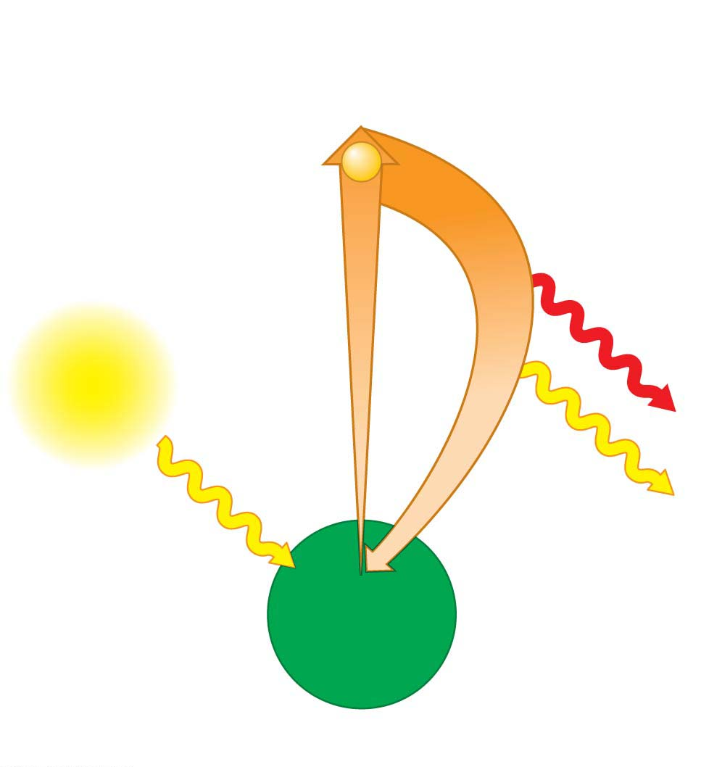
Figure 7.8-1
Excited state
The electron
falls to its
ground state.
Absorption of a
photon excites
an electron.
e⁻
Heat
Light
Light
(fluorescence)
Photon
Ground
state
Chlorophyll
molecule
(a) Absorption of a photon
Notes:
Figure 7.8-1 Excited electrons in pigments (part 1: absorption)

Slide 13
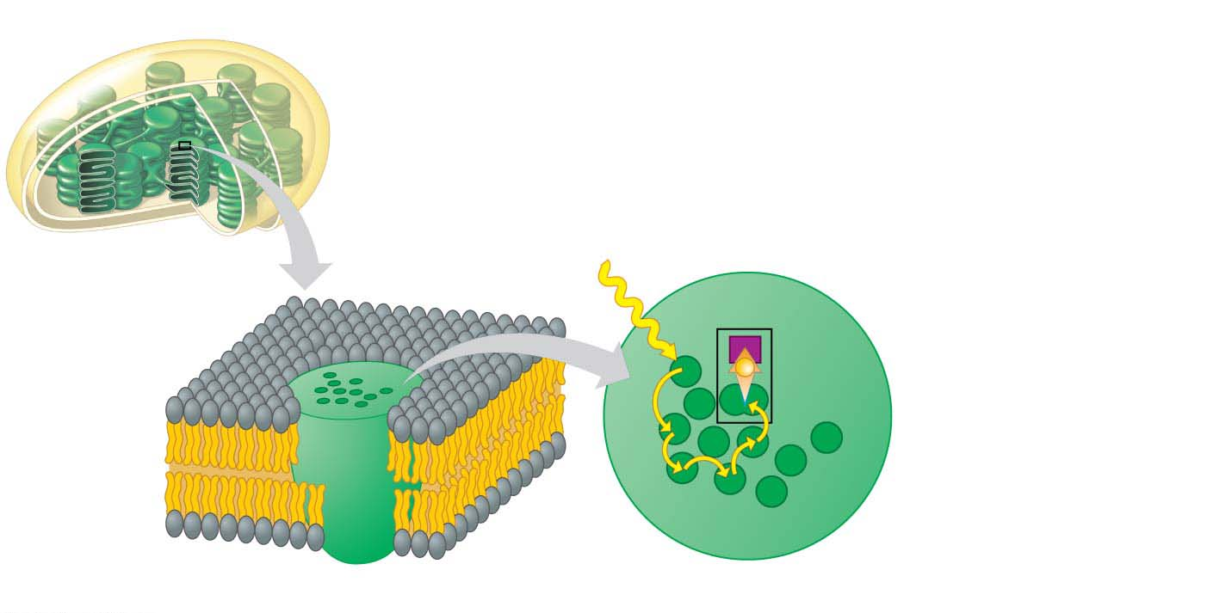
Figure 7.9
In the thylakoid membrane, chlorophyll molecules are organized with other molecules into photosystems.
Each photosystem has a cluster of a few hundred pigment molecules, including chlorophylls a and b and some carotenoids.
Chloroplast
Cluster of pigment
molecules
Photon
Primary
electron
acceptor
e⁻
Electron
transfer
Reaction-
center
chlorophyll a
Pigment
molecules
Transfer
of energy
Thylakoid membrane
Photosystem
Notes:
Figure 7.9 A photosystem: light-gathering molecules that focus light energy onto a reaction center

Slide 14
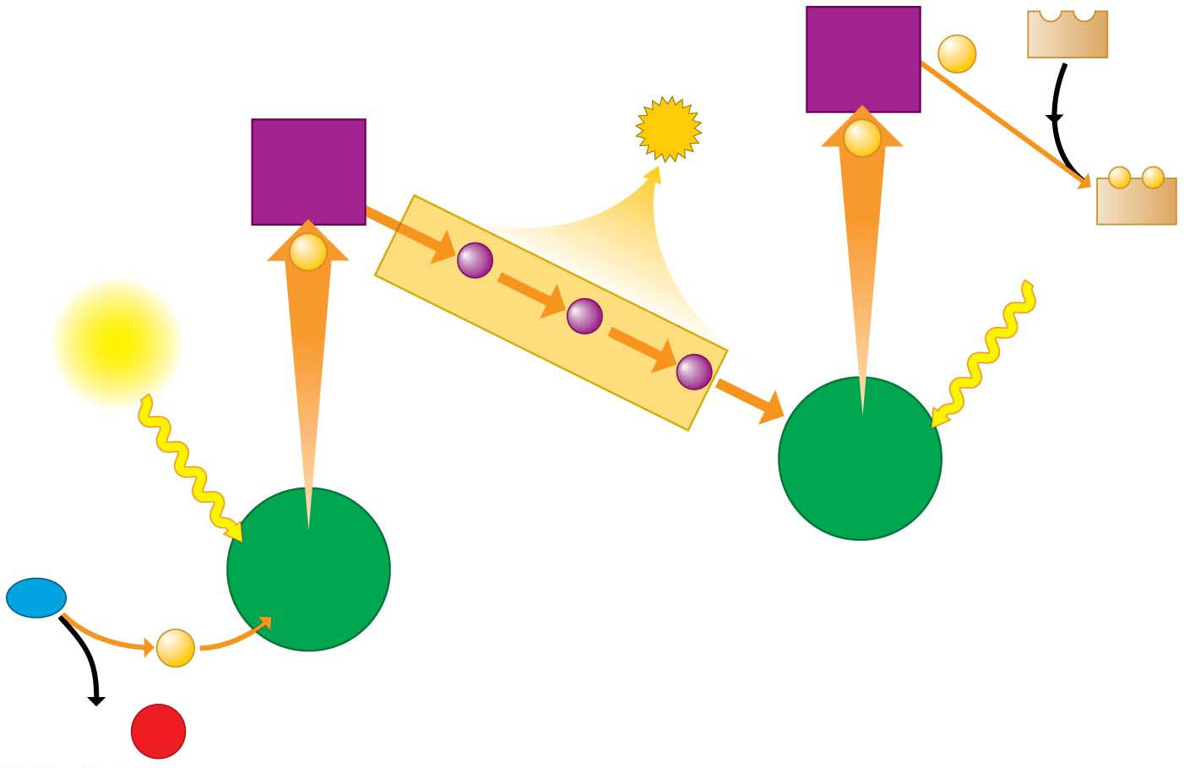
Figure 7.10
Primary
electron
acceptor
NADP⁺
2e⁻
Energy
to make
ATP
3
Primary
electron
acceptor
2e⁻
2
−
−
NADPH
2e⁻
Light
Light
Electron transport chain
Reaction-
center
chlorophyll
1
1
Reaction-
center
chlorophyll
Second photosystem
제2광계
H₂O
2e⁻
First photosystem
제1광계
2 H⁺ +
¹
²
O₂
Notes:
Figure 7.10 The light reactions of photosynthesis

Slide 15
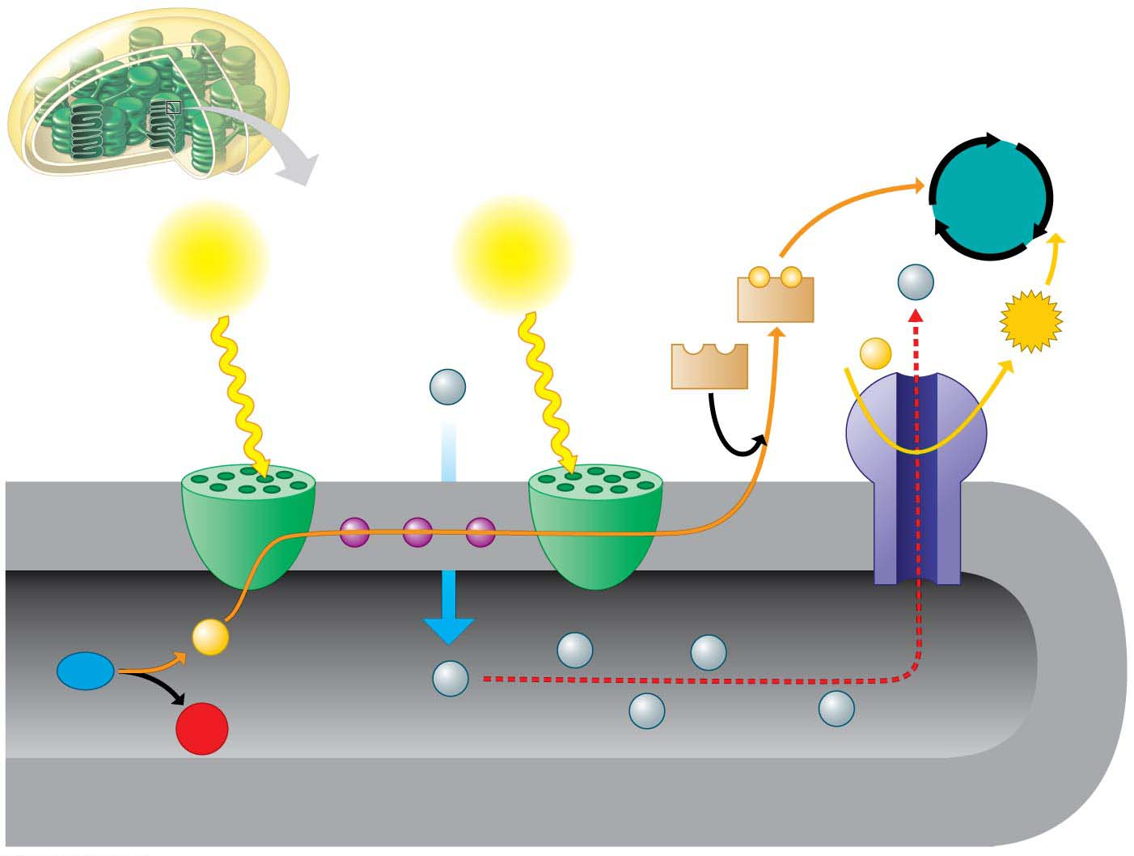
Figure 7.11
Calvin
cycle
Light
Light
−
−
H⁺
NADPH
ATP
+
ADP
P
NADP⁺
H⁺
Stroma
Electron
transport chain
Thylakoid
membrane
Photosystem
Photosystem
ATP
synthase
Inside thylakoid
Electron flow
2e⁻
H⁺
H⁺
H₂O
H⁺
1
2
H⁺
H⁺
O₂
Thylakoid
membrane
Notes:
Figure 7.11 How the thylakoid membrane converts light energy to the chemical energy of NADPH and ATP

Slide 16
The Calvin Cycle, C₃ pathway, carbon fixation cycle: Making Sugar from Carbon Dioxide
The Calvin cycle constructs an energy-rich sugar molecule called glyceraldehyde 3-phosphate (G3P) using
carbon from CO₂,
energy from ATP, and
high-energy electrons from NADPH.
The plant cell can then use G3P as the raw material to make
glucose and
other organic compounds.
Notes:
16
Student Misconceptions and Concerns
1. Glucose is not the direct product of the Calvin cycle, as might be expected from the general equation for photosynthesis. Instead, as noted in the text, G3P is the main product. Clarify the diverse uses of G3P in the production of many important plant molecules for students.
Teaching Tips
1. Some students do not realize that plant cells also have mitochondria. Instead, they assume that the chloroplasts are sufficient for the plant cell’s needs. Nearly 50% of the carbohydrates produced by plant cells are used for cellular respiration (involving mitochondria).

Slide 17
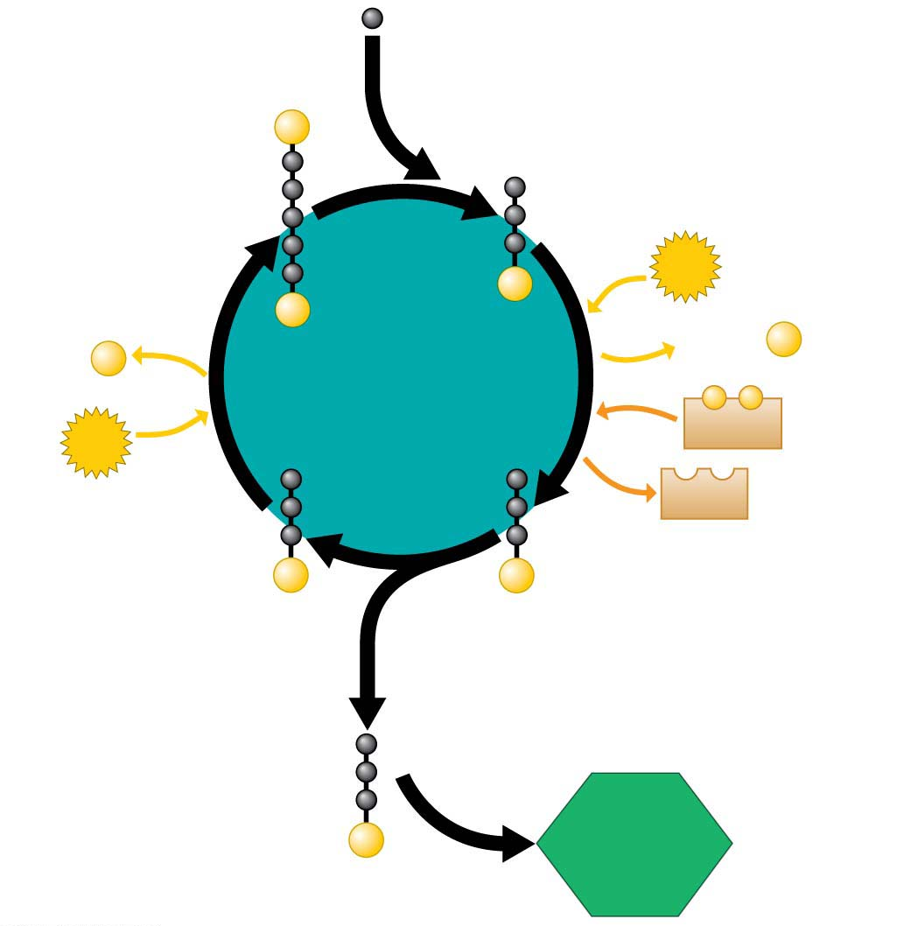
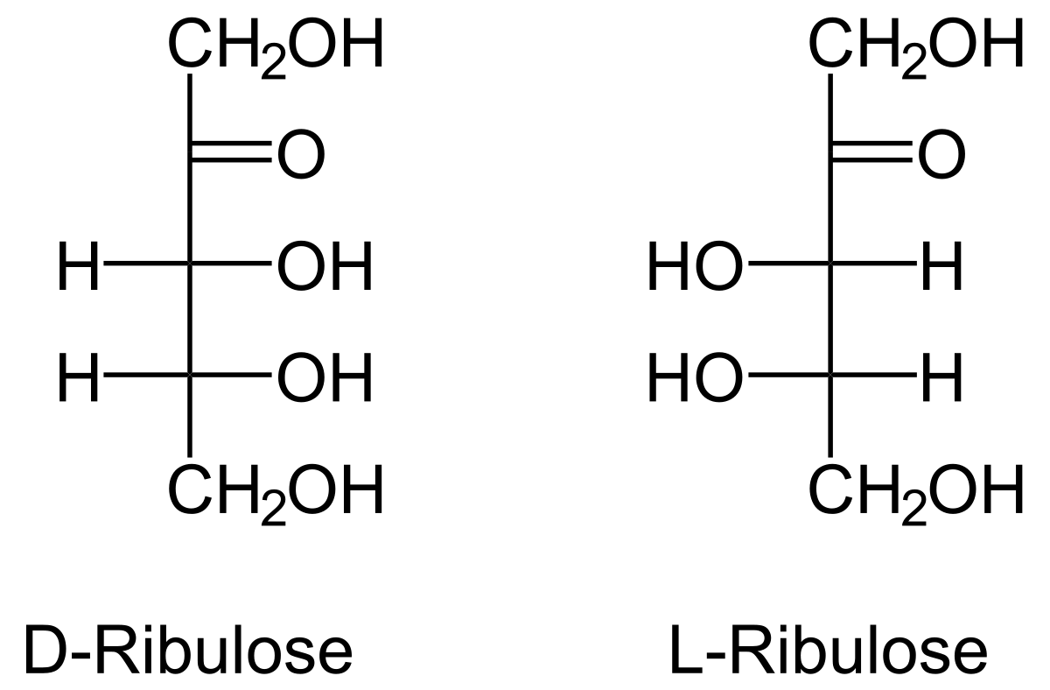
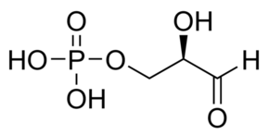
Figure 7.13-s4
CO₂ (from air)
1
Ribulose-1,5-bisphosphate
Carboxylase/oxygenase
1
P
RuBP sugar
Three-carbon molecule
4
ATP
P
P
+
Calvin
cycle
ADP
+
P
ADP
P
−
−
ATP
NADPH
NADP⁺
G3P sugar
G3P sugar
3
P
P
2
3
2
G3P sugar
Glucose
(and other
organic
compounds)
P
Notes:
Figure 7.13-s4 The Calvin cycle (step 4)

